Slide 1
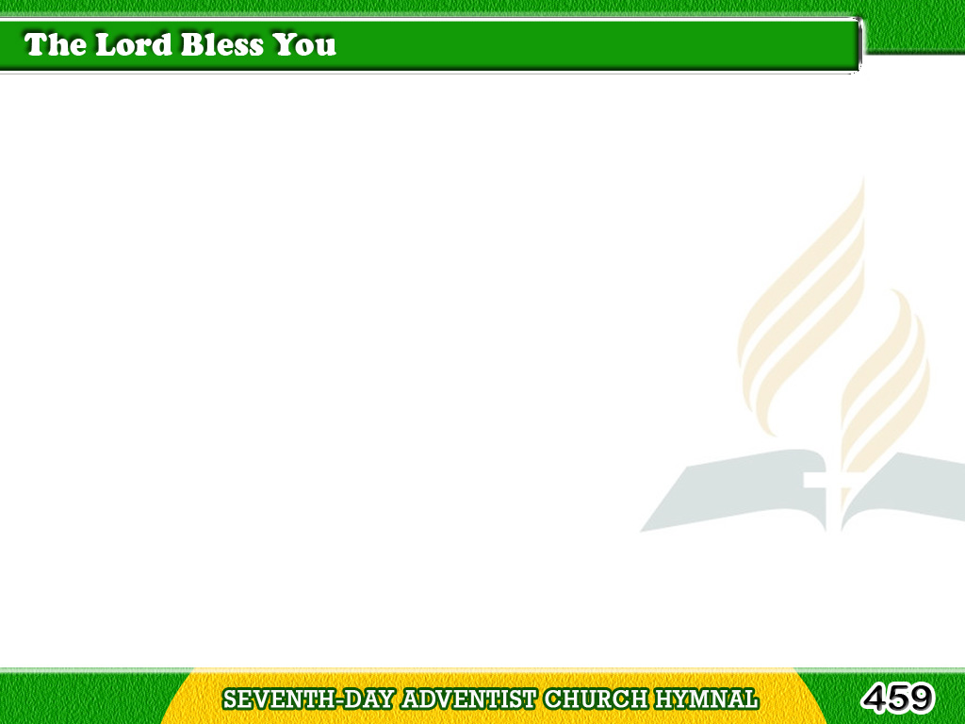
1/1
The Lord bless you and keep you;
The Lord lift His
countenance upon you,
and give you peace,
and give you peace;
Tagalog
Version

Slide 2
1/1
The Lord make His face
to shine upon you,
and be gracious unto you,
be gracious,
Tagalog
Version

Slide 3
1/1
The Lord be gracious,
gracious unto you. Amen.
Amen, Amen, Amen,
Amen, Amen, Amen.
Tagalog
Version

